Slide 1
History, Growth, Statistics and Future
CSC1720 – Introduction to Internet
Essential Materials

Slide 2
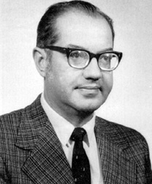
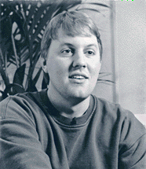

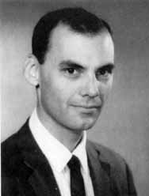

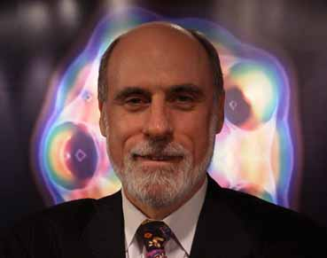
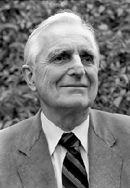
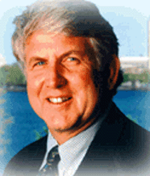
Who are they?
CSC1720 – Introduction to Internet
All copyrights reserved by C.C. Cheung 2003.

Slide 3
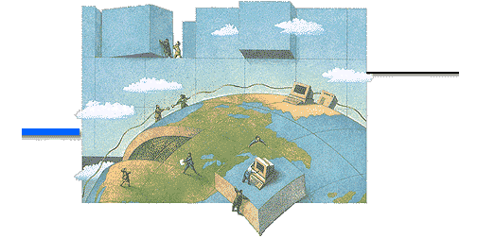
Outline
The Birth of Internet
Internet Pioneers
ARPA & ARPANET
Switching Network
Growth of the Internet
Who governs the Internet
The development in China
The Future Prospects
CSC1720 – Introduction to Internet
All copyrights reserved by C.C. Cheung 2003.

Slide 4
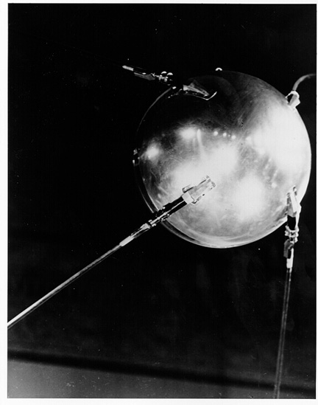
The Birth of ARPA
In 1957, USSR launches the first artificial earth satellite - Sputnik.
In 1958, US forms the Advanced Research Projects Agency (ARPA)
ARPA directly reports to the US Department of Defense (DoD) and develops state-of-the-art technology in order to maintain the leading military research position.
CSC1720 – Introduction to Internet
All copyrights reserved by C.C. Cheung 2003.

Slide 5
The evolution of ARPAnet
The 1st Packet-Switching (PS) paper was presented in 1961.
PS-network was presented to the ARPA in 1968. The request for the proposals of ARPA Network (ARPANET) was sent in the same year.
In 1969, the ARPANET commissioned by DoD for research into networking.
Only 4 nodes comprise the ARPANET.
CSC1720 – Introduction to Internet
All copyrights reserved by C.C. Cheung 2003.

Slide 6
Packet Switching or Circuit Switching?
Circuit Switching
  A network that provides data channels for the sole use by a single user.
Packet Switching
  Message is broken into pieces of data and is transmitted over the network.
Demo now!
CSC1720 – Introduction to Internet
All copyrights reserved by C.C. Cheung 2003.

Slide 7
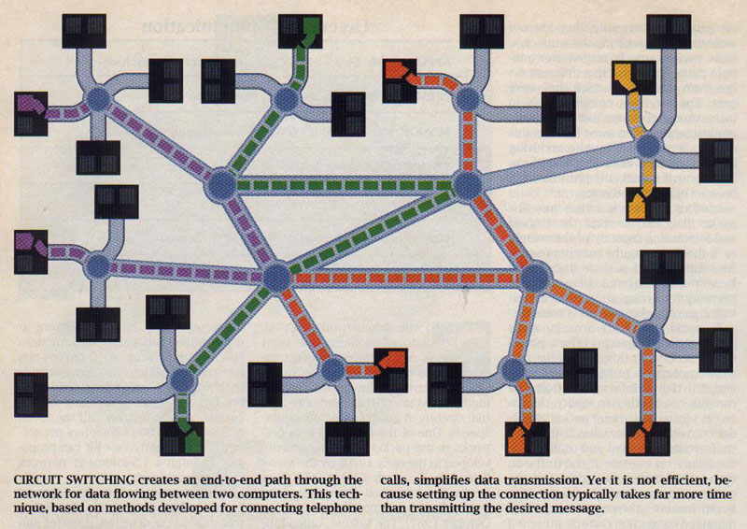
Circuit Switching
CSC1720 – Introduction to Internet
All copyrights reserved by C.C. Cheung 2003.

Slide 8
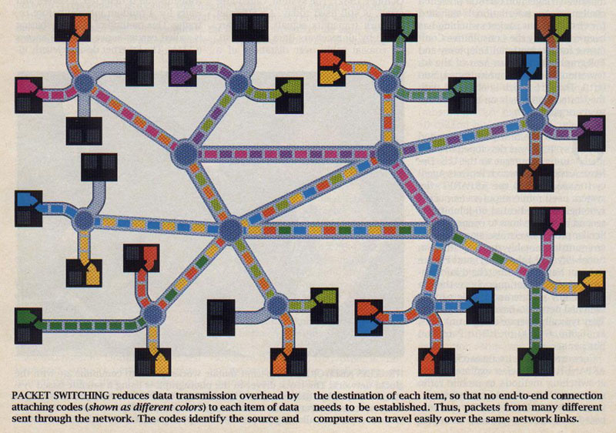
Packet Switching
CSC1720 – Introduction to Internet
All copyrights reserved by C.C. Cheung 2003.

Slide 9
The first ARPANET
Nodes are connected by AT&T 50kbps lines.
Node 1: University of California Los Angeles (UCLA), Host is SDS SIGMA7
Node 2: Stanford Research Institute (SRI), Host is SDS940
Node 3: University of California Santa Barbara (UCSB), Host is IBM 360/75
Node 4: University of Utah, Host is DEC PDP-10
CSC1720 – Introduction to Internet
All copyrights reserved by C.C. Cheung 2003.

Slide 10
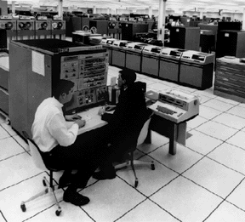
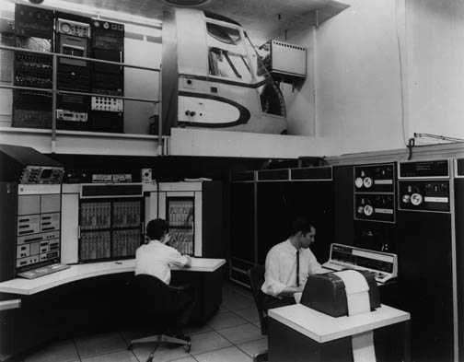
Hosts
IBM 360/75 DEC PDP-10
CSC1720 – Introduction to Internet
All copyrights reserved by C.C. Cheung 2003.

Slide 11
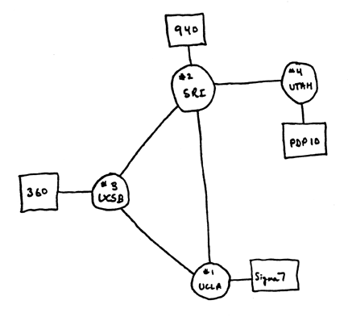
Diagram of the 4-nodes ARPANET
CSC1720 – Introduction to Internet
All copyrights reserved by C.C. Cheung 2003.

Slide 12
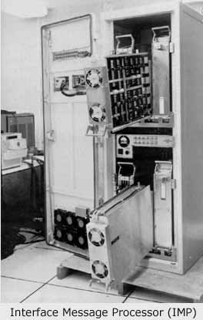
Interface Message Processor (IMP)
4 IMPs were connected, ARPANET was born.
CSC1720 – Introduction to Internet
All copyrights reserved by C.C. Cheung 2003.

Slide 13
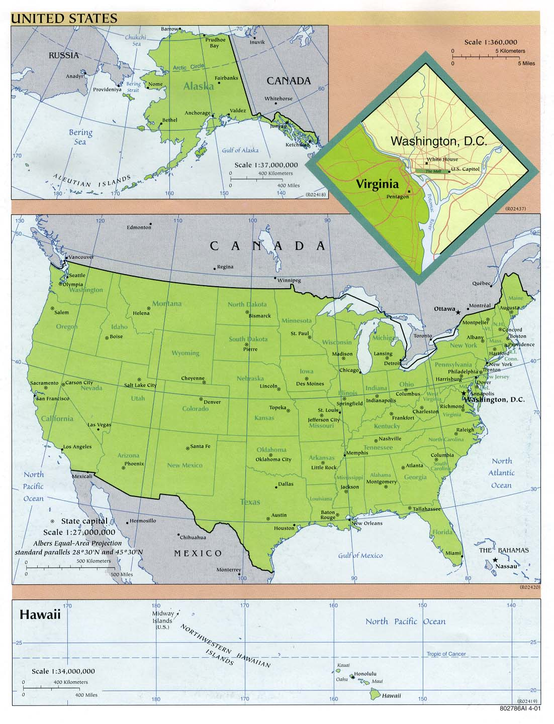

Geographical
Position
Host 1(UCLA)
Host 2 (SRI)
Host 3 (UCSB)
Host 4 (Utah)
CSC1720 – Introduction to Internet
All copyrights reserved by C.C. Cheung 2003.

Slide 14
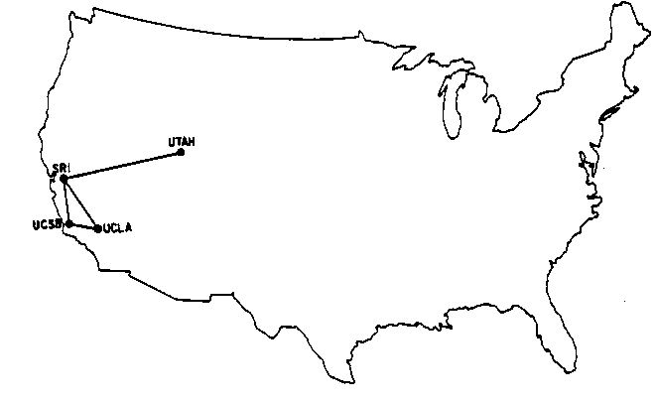
Geographical Position
CSC1720 – Introduction to Internet
All copyrights reserved by C.C. Cheung 2003.

Slide 15
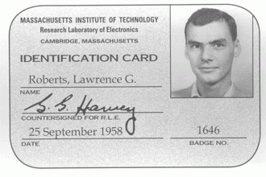
The father of ARPANET
Larry Roberts is the principal architect of the ARAPNET
CSC1720 – Introduction to Internet
All copyrights reserved by C.C. Cheung 2003.

Slide 16
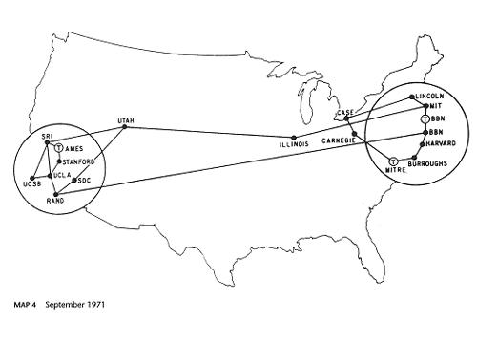
The growth of ARPANET
1971, 15 nodes (23 hosts): UCLA, SRI, UCSB, Univ of Utah, MIT, Harvard, Stanford, UIUC, CMU, NASA, etc…
CSC1720 – Introduction to Internet
All copyrights reserved by C.C. Cheung 2003.

Slide 17
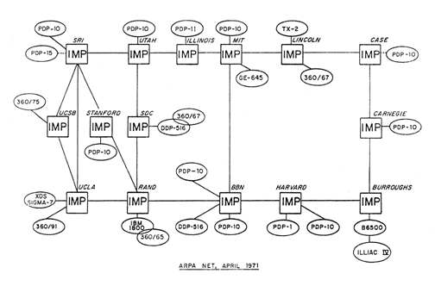
The growth of ARPANET
1971, 15 nodes (23 hosts): UCLA, SRI, UCSB, Univ of Utah, MIT, Harvard, Stanford, UIUC, CMU, NASA, etc…
CSC1720 – Introduction to Internet
All copyrights reserved by C.C. Cheung 2003.

Slide 18

The growth of ARPANET
Ray Tomlinson invents email program (1971), introduce the use of “@”.
ALOHAnet (first packet radio network) from Univ of Hawaii, join ARPANET in 1972.
1973, study shows email compose 75% of the ARPANET traffic.
Elizabeth II sent an email in 1976.
CSC1720 – Introduction to Internet
All copyrights reserved by C.C. Cheung 2003.

Slide 19
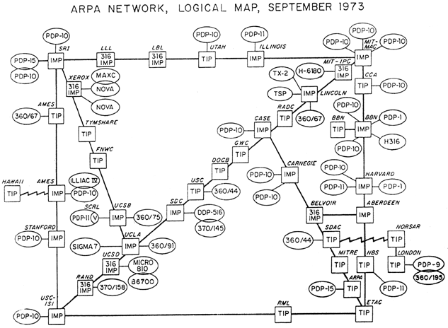
The ARPANET - 1973
CSC1720 – Introduction to Internet
All copyrights reserved by C.C. Cheung 2003.

Slide 20
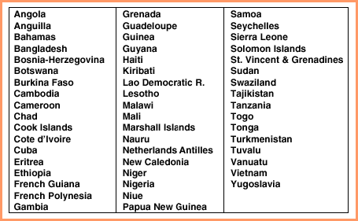

Figure 10.1 Countries in 1977 that could send or receive email but were not connected to the Internet.
CSC1720 – Introduction to Internet
All copyrights reserved by C.C. Cheung 2003.

Slide 21
Late 1970s, Early 1980s
Many networks were built
  In 1981, BITNET, the “Because It’s Time NETwork” started as cooperative network.
  CSNET (Computer Science NETwork) seeds grant support by National Science Foundation (NSF) and provides connection between universities.
  EUnet (European UNIX Network)
  JUNET (Japan UNIX Network)
  JANET (Joint Academic Network) in UK
CSC1720 – Introduction to Internet
All copyrights reerved by C.C. Cheung 2003.

Slide 22
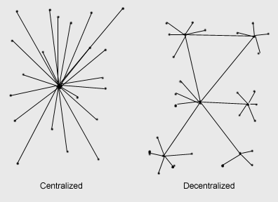
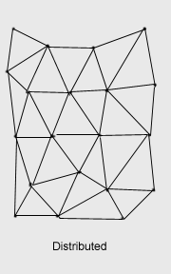
Why Decentralized?
Why Distributed?
Centralized model – attack the central point, any counter-attack?
CSC1720 – Introduction to Internet
All copyrights reserved by C.C. Cheung 2003.

Slide 23
Distributed Network
Paul Baran has 2 important ideas to the development of ARPANET
  Distributed network
  Packet switching
CSC1720 – Introduction to Internet

Slide 24
NSFNET
In 1986, NSFNET was created (backbone speed of 56Kbps)
Connected 5 supercomputing centers.
  JVNC@Princeton
  PSC@Pittsburgh
  SDSC@UCSD
  NCSA@UIUC
  Theory Center@Cornell
CSC1720 – Introduction to Internet
All copyrights reserved by C.C. Cheung 2003.

Slide 25
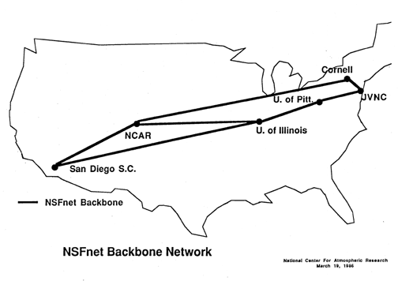
NSFNET - Backbone
CSC1720 – Introduction to Internet
All copyrights reserved by C.C. Cheung 2003.

Slide 26
Expansion of hosts
Number of hosts breaks 10,000 in 1987
NSFNET backbone upgraded to T1 (1.5M) 1988
Number of hosts breaks 100,000 in 1989
NSFNET upgraded to T3 (44.736Mbps) 1991
Number of hosts breaks 1,000,000 in 1992
CSC1720 – Introduction to Internet
All copyrights reserved by C.C. Cheung 2003.

Slide 27
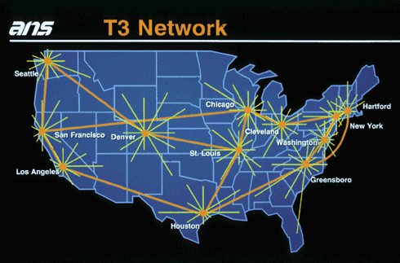
T3 Backbone
CSC1720 – Introduction to Internet
All copyrights reserved by C.C. Cheung 2003.

Slide 28
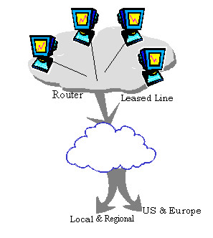
Trunk Bandwidth
T1 – Trunk Level 1
A T3 line is comprised of 28 T1 lines, each operating at total signaling rate of 1.54 Mbps.
  T1 – 1.5Mbps, T2 – 6Mbps, T3 – 45Mbps
European Standard – E
  E1 – 2Mbps, E2 – 8Mbps, E3 – 34Mbps, E4 – 140Mbps
CSC1720 – Introduction to Internet
All copyrights reserved by C.C. Cheung 2003.

Slide 29
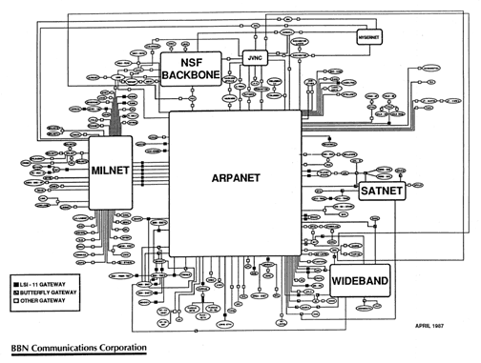
The Internet - 1987
CSC1720 – Introduction to Internet
All copyrights reserved by C.C. Cheung 2003.

Slide 30
The emergence of the Internet
Department of
Defense
(DoD)
National Science
Foundation
NSF
Other
Funding
CSNET
BITNET
ARPANET
NSFNET
JANET
MilNET
Internet
ALOHANET
CSC1720 – Introduction to Internet
All copyrights reserved by C.C. Cheung 2003.

Slide 31
The father of the Internet
Vint Cerf defines the network protocol and breaks the independent self-contained networks, forms TCP/IP which becomes the standard
CSC1720 – Introduction to Internet
All copyrights reserved by C.C. Cheung 2003.

Slide 32
Networking Technology
Local Area Network (LAN)s are very popular in 1980s, especially in Universities.
Many workstations were connected by Ethernet which was invented by Bob Metcalfe
CSC1720 – Introduction to Internet
All copyrights reserved by C.C. Cheung 2003.

Slide 33
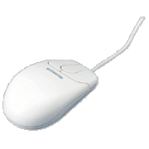
Who creates Mouse?
Can you surf without the use of mouse?
We should thank Douglas Englebart for his invention.
CSC1720 – Introduction to Internet
All copyrights reserved by C.C. Cheung 2003.

Slide 34
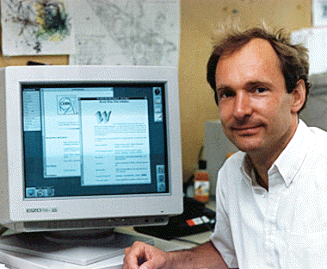
The Invention of WWW
The World Wide Web (WWW) was created by Tim Berners-Lee at European Laboratory for Particle Physics (CERN) in 1991
Together with Robert Cailliau wrote the first WWW client and server
CSC1720 – Introduction to Internet
All copyrights reserved by C.C. Cheung 2003.

Slide 35
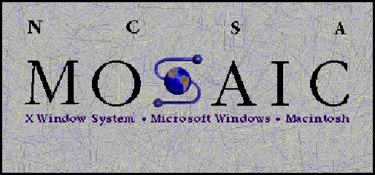
Browser evolution
Mosaic takes the Internet, 1993
  A graphical WEB browser, WWW client which was released by Marc Andreesen at NCSA (National Center for Supercomputing Applications) in the University of Illinois in Urbana-Champaign (UIUC)
Netscape, 1994
  Marc Andreessen and Jim Clark
  1996, 75% uses Netscape
  It was bought by America Online in 1999 (10 Billion in stock)
CSC1720 – Introduction to Internet
All copyrights reserved by C.C. Cheung 2003.

Slide 36
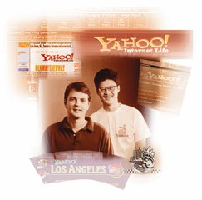
Billionaire – Jerry Yang
David Filo & Jerry Yang started Yahoo when they were doing their PhD studies at Stanford University in 1994
Yahoo is one of the famous search engine on the NET.
CSC1720 – Introduction to Internet
All copyrights reserved by C.C. Cheung 2003.

Slide 37
Internet Worm
In 1988, Robert Morris, graduate student in Computer Science at Cornell, wrote an experimental, self-replicating, self-propagating program “a worm”
Distribute itself to over 6,000 of the 60,000 computers that were on the Internet at that time.
He was sentenced to 3 years of probation, 400 hours of community, a fine of $10,050.
CSC1720 – Introduction to Internet
All copyrights reserved by C.C. Cheung 2003.

Slide 38
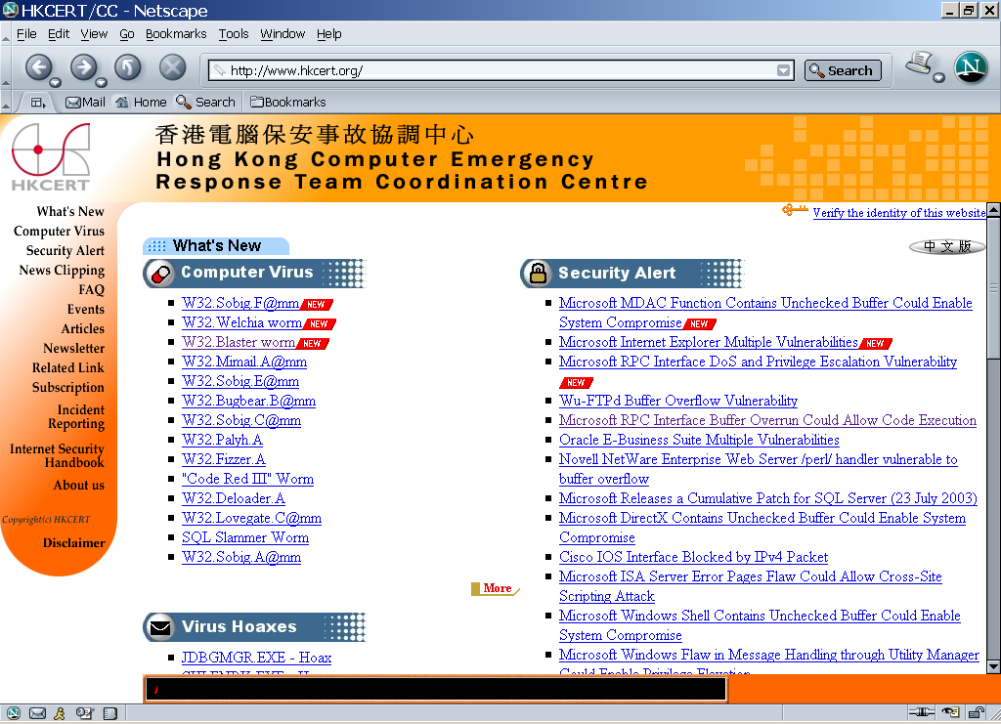
Recent Threats
CSC1720 – Introduction to Internet
All copyrights reserved by C.C. Cheung 2003.

Slide 39
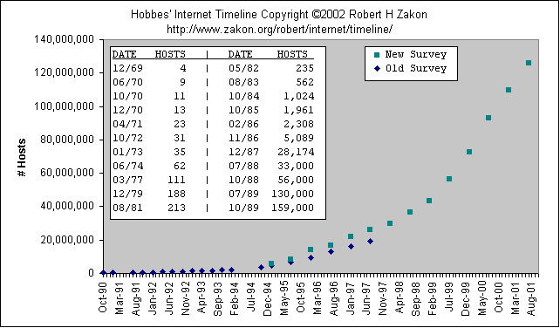
Growth of the Internet Hosts
CSC1720 – Introduction to Internet
All copyrights reserved by C.C. Cheung 2003.

Slide 40
Some Statistics
At January 2000, there are 72,398,092 hosts connecting to the Internet.
At June 2000, there are 17,119,262 web servers.
At July 1997, there are 1,301,000 domains.
At July 1997, there are 171 countries connecting to the Internet.
CSC1720 – Introduction to Internet
All copyrights reserved by C.C. Cheung 2003.

Slide 41
Interesting Facts
25,000 new users daily
325 million users (October 2000)
50% of users are female
73 million hosts (October 2000)
200+ countries connected
World Wide Web sites double every two months
CSC1720 – Introduction to Internet
All copyrights reserved by C.C. Cheung 2003.

Slide 42
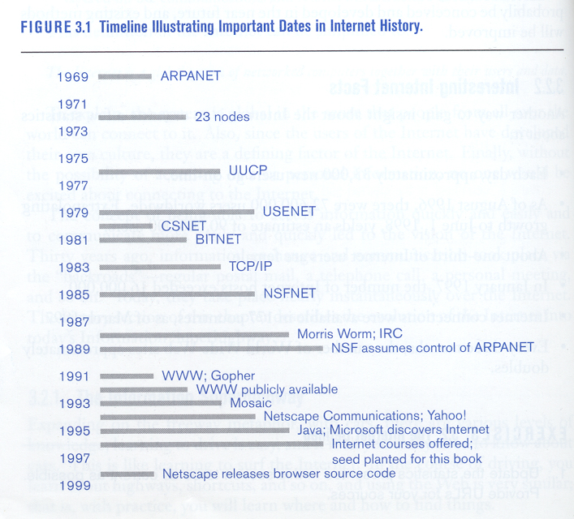
Internet History
CSC1720 – Introduction to Internet
All copyrights reserved by C.C. Cheung 2003.

Slide 43
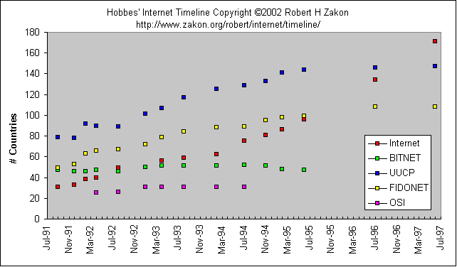
Growth of the Internet Networks
CSC1720 – Introduction to Internet
All copyrights reserved by C.C. Cheung 2003.

Slide 44
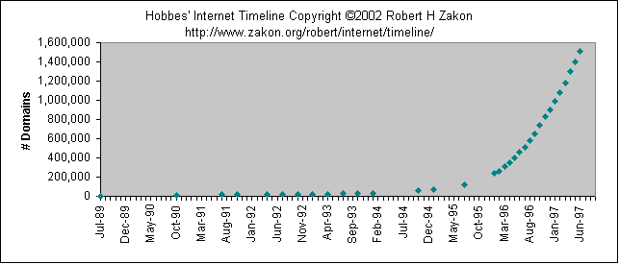
Growth of the Internet Domains
CSC1720 – Introduction to Internet
All copyrights reserved by C.C. Cheung 2003.

Slide 45
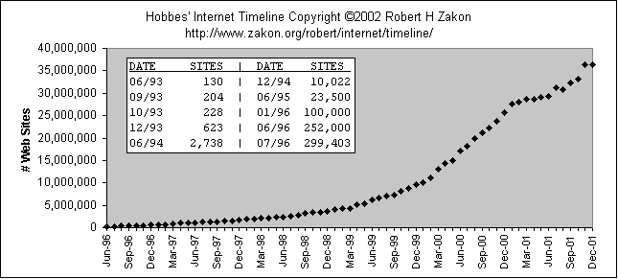
Growth of the Internet Web Sites
CSC1720 – Introduction to Internet
All copyrights reserved by C.C. Cheung 2003.

Slide 46
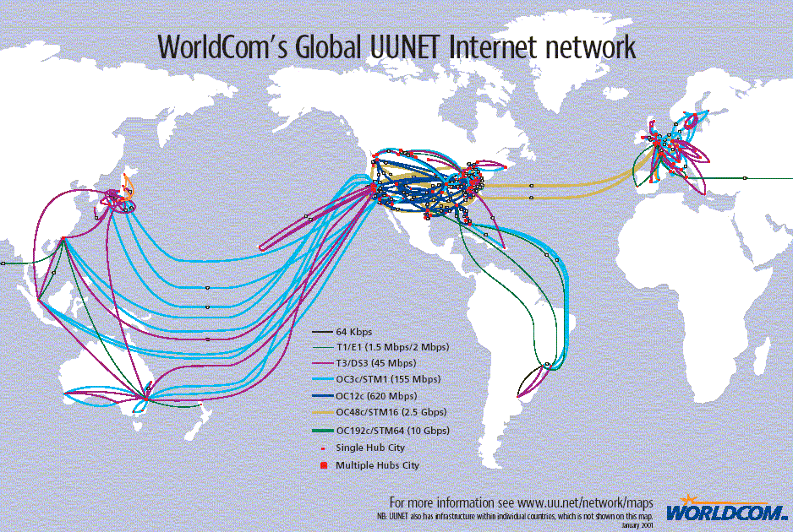
An example global backbone network
CSC1720 – Introduction to Internet
All copyrights reserved by C.C. Cheung 2003.

Slide 47


Who governs the Internet?
NOBODY!!
Internet Society (ISOC)
  Professional membership society
World Wide Web Consortium
  develops technologies (specifications, guidelines, software, and tools)
Internet Network Information Center (InterNIC)
  Domain registration
CSC1720 – Introduction to Internet
All copyrights reserved by C.C. Cheung 2003.

Slide 48


Who governs the Internet?
Internet Corporation for Assigned Names and Numbers (ICANN)
  responsibility for the IP address space allocation, protocol parameter assignment, domain name system management, and root server system management
Internet Engineering Task Force (IETF)
  a large open international community of network designers, operators, vendors, and researchers
CSC1720 – Introduction to Internet
All copyrights reserved by C.C. Cheung 2003.

Slide 49
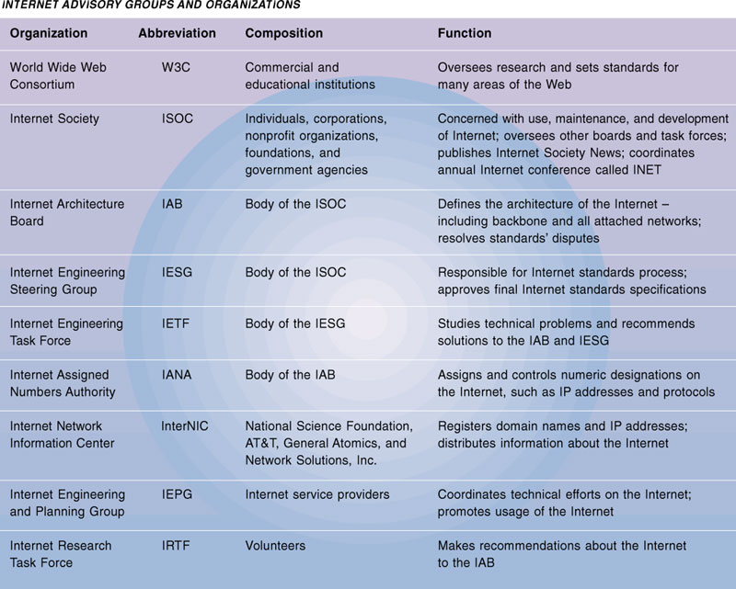
Who governs the Internet?
CSC1720 – Introduction to Internet
All copyrights reserved by C.C. Cheung 2003.

Slide 50




Who manages IP address?
Internet Assigned Numbers Authority (IANA)
  APNIC (Asia-Pacific Network Information Center)
    Asia Pacific
  ARIN (American Registry for Internet Numbers )
    North America, South America, the Caribbean and sub-Saharan Africa.
  RIPE NCC (Réseaux IP Européens)
    Europe, Middle East, parts of Africa
CSC1720 – Introduction to Internet
All copyrights reserved by C.C. Cheung 2003.

Slide 51
The Internet Development in China
Sept, 1987 – a professor in Beijing sends out the first email in China
Oct, 1990 – China registers the country’s domain name “cn” at InterNIC
Sept, 1994 – China Telecom signs an agreement to open two 64K lines in Beijing and Shanghai
Jan, 1996 – China Public Computer Internet (CHINANET) opens
Jun, 1999 – 1.46 million computers connected to the Internet and 4 million Internet subscribers, 29,045 .cn domain names and 9,906 web sites
Nov, 2002 – 145,427 .cn domain names, …
CSC1720 – Introduction to Internet
All copyrights reserved by C.C. Cheung 2003.

Slide 52
An Internet Odyssey
Please suggest what will happen in 2010 to the Internet?
  De-Mobilization of Free Expression?
  People listening today, more people will be listening tomorrow
  Not a substitute for communicating with people
  Still expanding very fast – IPv6!
CSC1720 – Introduction to Internet
All copyrights reserved by C.C. Cheung 2003.

Slide 53
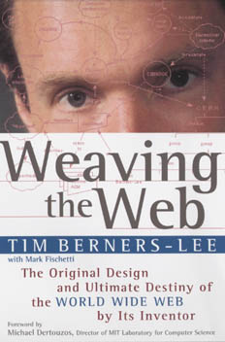
References
Hobbes’ Internet Timeline
Internet Pioneers
Zen and the art of the Internet
Life on the Internet
China NIC
Berners-Lee, Tim. (1999). Weaving the Web. San Francisco: HarperCollins.
Class Exercise:
  Question: What is Internet2?
CSC1720 – Introduction to Internet
All copyrights reserved by C.C. Cheung 2003.

Slide 54
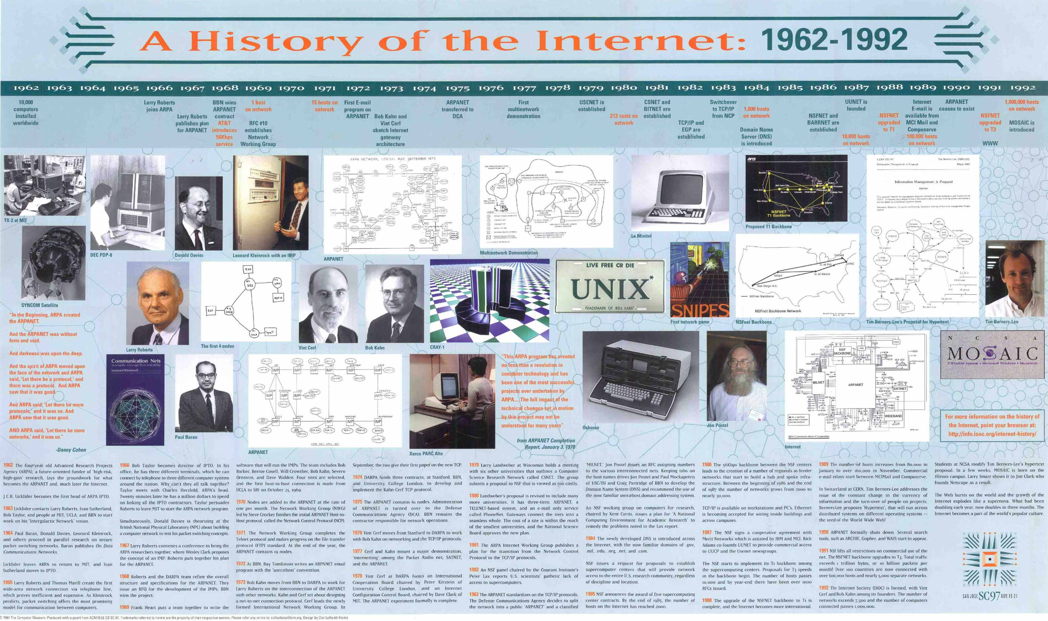
The End
Thank you for your patience!
Source:"A History Of The Internet: 1962-1992", by The Computer Museum (TCM)
CSC1720 – Introduction to Internet
All copyrights reserved by C.C. Cheung 2003.

